Slide 1
Database Project
By James Harper

Slide 2
Project Scope
SQL database
C.R.U.D functionality
Kanban board
Entity Relationship Diagram
Git integration
Testing
C.R.U.D changes
SQL database changes
Entity Relationship Diagram changes
Mockito
Unit testing

Slide 3
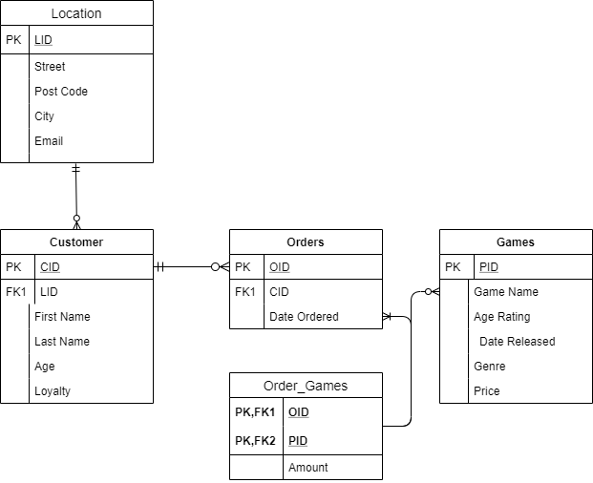
Entity Relationship Diagram
Many, one to many relationships
One many to many relationship

Slide 4
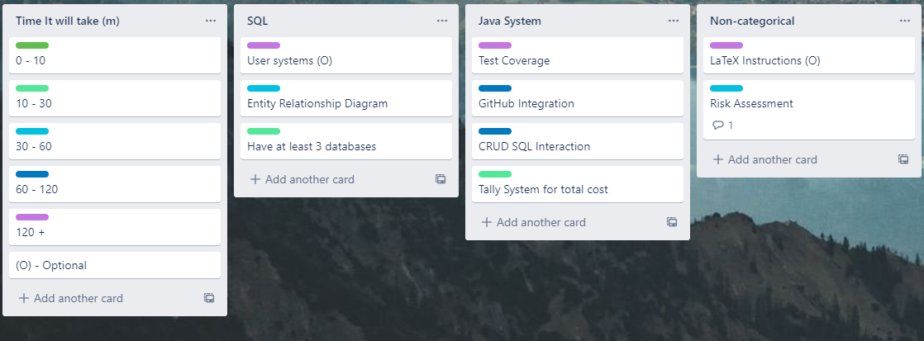
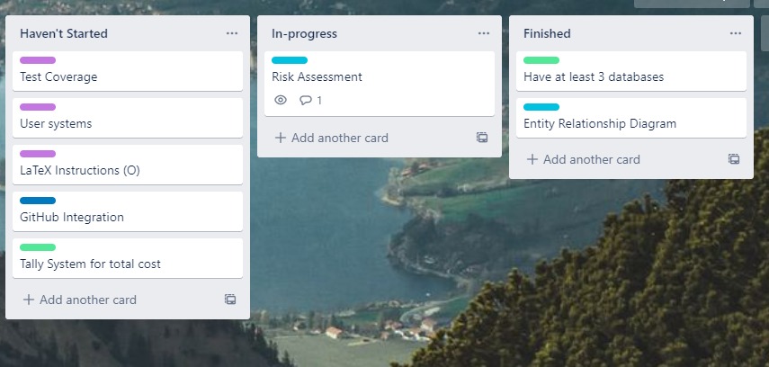
Trello Board Start
Knew testing wouldn’t be easy
User System in SQL
LaTeX Instructions
Risk Assessment Not In Scope

Slide 5
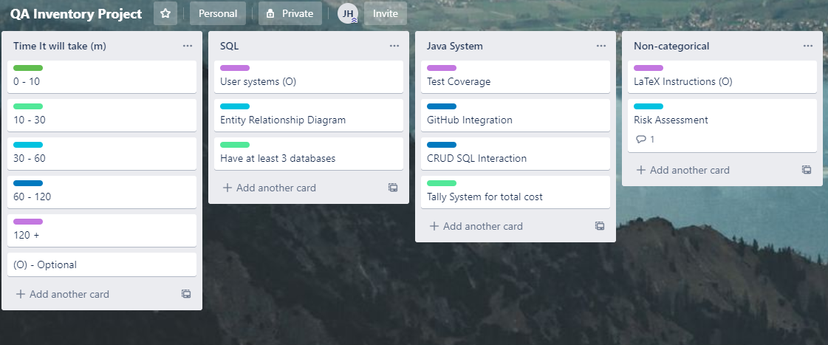
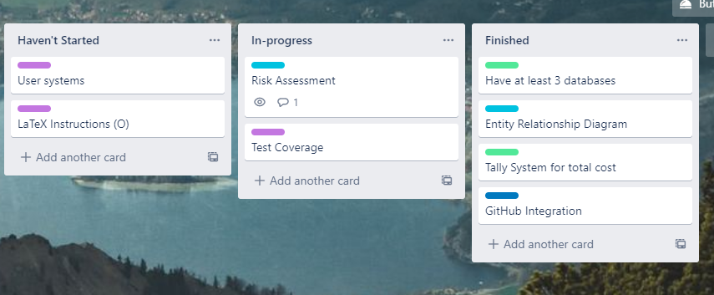
Trello Board End
Testing wasn’t easy
Thought Tally System Would Be Harder

Slide 6
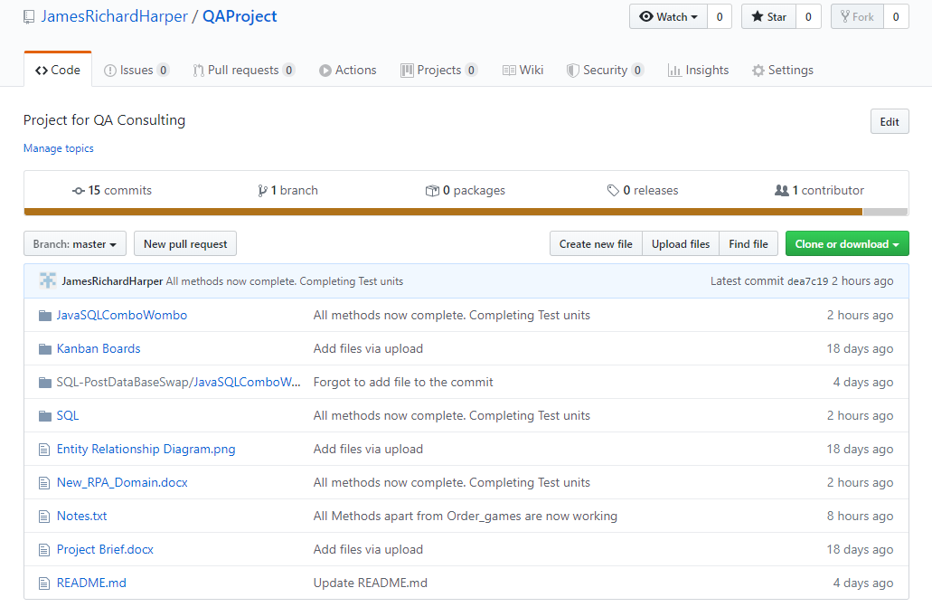
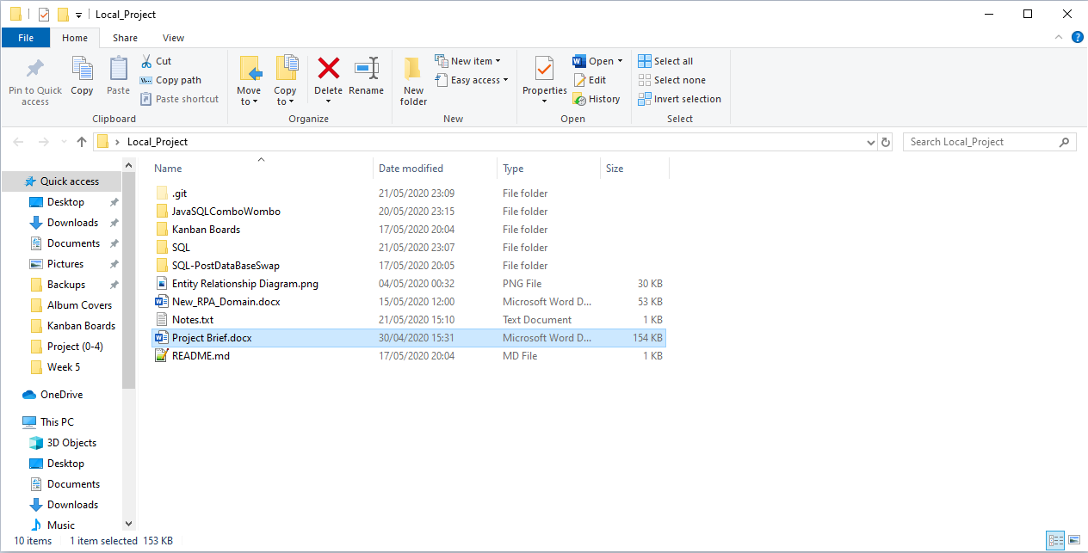

Git
Initial use of website
Transition to Gitbash

Slide 7
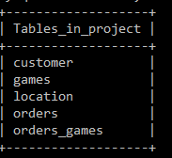
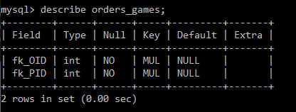
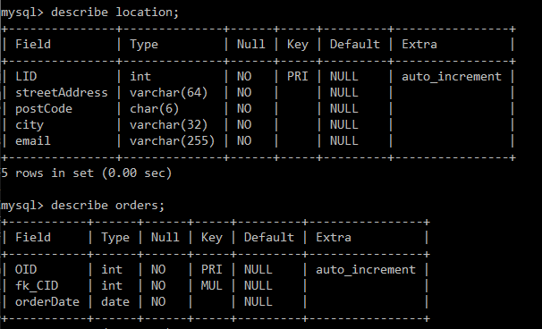
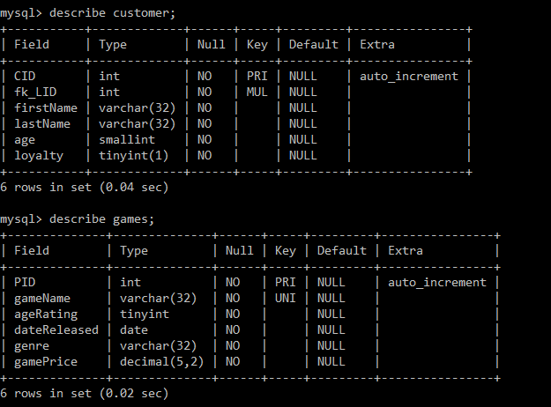
SQL Database Changes
Tables added to reflect real database
More code to write
More tests to write

Slide 8
Code
Create, Read, Update, Delete all completed.
Options added for expansion.
Delete has some exceptions, references for example.
Create and Update return void.
Create doesn’t return ID.
Testing becomes difficult.
Return executequery(input) for tests.

